Slide 1

Customer Profitability Analysis
Project :- Customer Profitability Analysis
Ruby Bala Mishra
Batch:-2022-7265

Slide 2
Customer Profitability Analysis
CONTINENTS OF MICROSOFT POWER BI
Slide 3 :-What is Power BI, Why we are using Power BI or benefits of Power BI..
Slide 4 :- What is Customer Profitability, small brief about Revenue, Income and Margin.
Slide 5 :- Industry Revenue Analysis…. different type of chart like Donut, line and clustered column chart , area chart , card and slicer are using which is showing in which product have maxim and minim Revenue, GM(Gross Margin) and calculated column etc.
Slide 6 :- Team Scorecard….. Here we also using different type of chart like Area Chart, Radar chart2.0.2,Map, line and clustered column chart , Sunburst by MAQ software.
Slide 7 :- Executive Scorecard….. Here we are using only two type of chart Tree Map, line and clustered column chart, slicer and cards.
Slide 8 :- In External Tools we used Tabular Editor for KPI( key performance indicator).
Slide 9 :-Benefits of customer profitability analysis.
https://github.com/rubymishra2022

Slide 3

Customer Profitability Analysis
What is POWER BI?
Microsoft's data analysis tool Power BI is especially suitable for analyzing data from Dynamics NAV, data visualization and reporting reports.
Benefits of Power BI or Why we are using POWER BI
Data Analysis Power BI can collect our company data, whether it's located in the cloud or locally, and provides quick and easy access to this data. Our customers get a live 360 ° view of their business, enabling them to search and explore their data quickly and easily.
Interactive reporting Customers can see all data on only one screen and the Power BI Mobile apps are automatically updated with changes to our data so we can access updated data and reports no matter where we are or whenever we need it.
Financial overview In just a few seconds, Power BI gives you the full picture of our data across different data sources. Therefore, we can see all our financial data in a single view.
User-friendly mobility With the tools we can explore the underlying data, which makes it easy to find exactly the answers we need.
Data Visualization With Power BI we can be both creative and productive. Combine data from various databases, files and web services with the visual tools in Power BI and gain unique insight into our data.

Slide 4

Customer Profitability Analysis
A profitable customer is a person, household, or company that over time yields a revenue stream exceeding by an acceptable amount the company’s cost stream for attracting, selling, and serving that customer. Note the emphasis is on the lifetime stream of revenue and cost, not the profit from a particular transaction.
REVENU:-Sara’s Photography Ltd provides a wide range of services, including portrait photos, wedding shots, family photos, and special occasions. She charges clients for these services upfront and at the end of the year, enters all the invoices into a spreadsheet and determines that her is $248,120.
INCOME:- Income can sometimes be used to mean revenue, or it can also be used to refer to net income, which is revenue less operating expenses Tom’s Pizza ltd sells pizzas, soft drinks, snacks, and dips directly to customers. The customers either pay for the products with a credit card or with cash. At the end of the year, Tom gives his accountant all the receipts from sales, as well as invoices and receipts for all employee wages, supplies, energy, and food/drink costs. His accountant takes all the receipts and tells Tom his is $125,869.
MAGIN:-Margin is the money borrowed from a broker to purchase an investment and is the difference between the total value of an investment and the loan amount.
Notes:
A

Slide 5
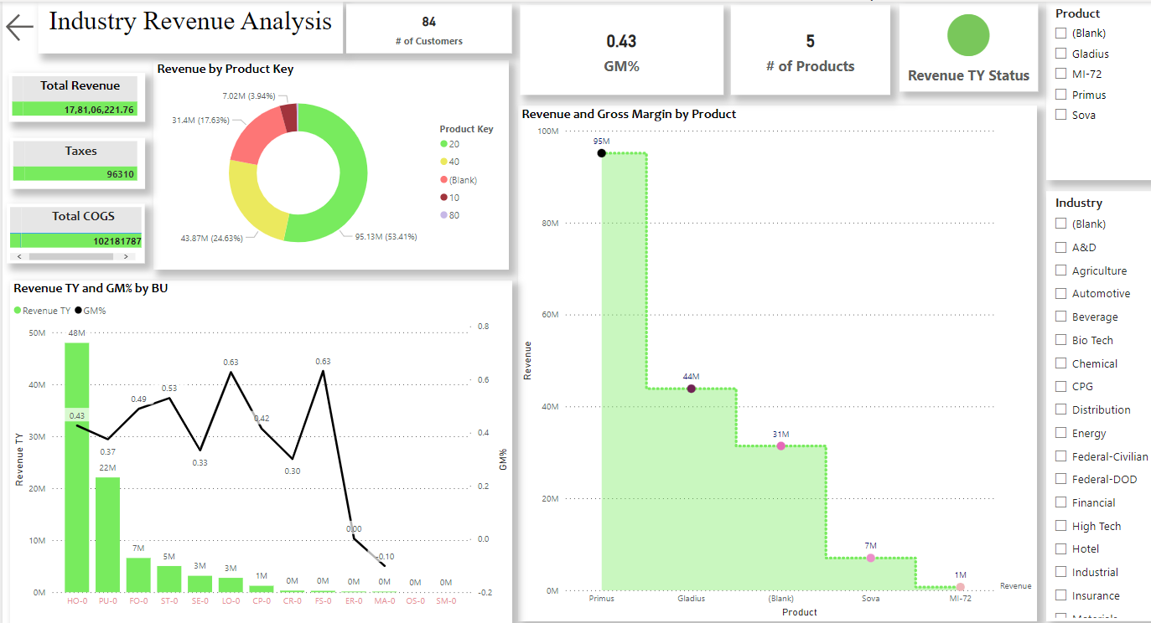
Customer Profitability Analysis
🎢 Industry Revenue Analysis
Donut is revel to which Product Key is maximum Revenue generate. Therefore Product Key ‘20’ is maximum 53.41% revenue generate and Product key ‘10’ is generate 3.94% which is minimum.
Line and Clustered column chart is revel to Revenue TY and GM% by BU. Maximum BU(Business Unit) HO-0 is generate in 48 M, maximum Revenue TY 4,79,633,551.33 And minimum BU MD-0 is 68,1360(Revenue TY). Maximum gross margin% ‘0.63’ in BU ‘FS-0’.
Area Chart is related to here Revenue and Gross Margin by Product. Here we can see product ‘primus’ is generate maximum %GT count of revenue with 61.85% with GM 4,05,68,117. and minimum %GT count of revenue with % with GM 35,39,983.

Slide 6
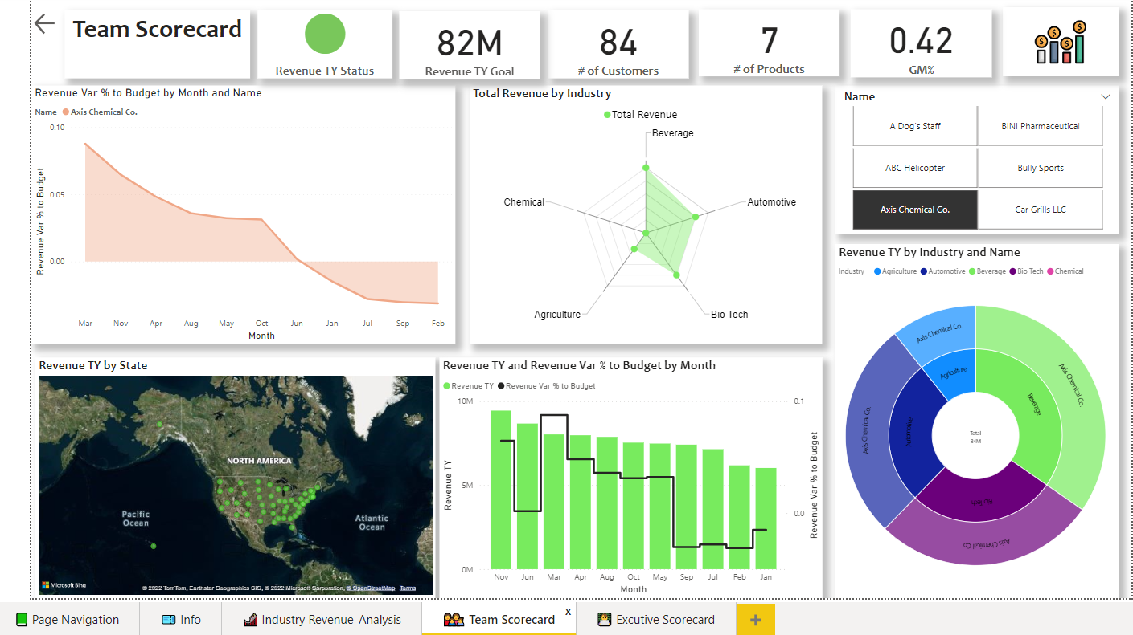
Customer Profitability Analysis
Team Scorecard
Area Chart its revel to Revenue Var % to Budget by Months and Name. here we can see in march month Revenue Var(value of risk) % to Budget of maxim raise in graph 0.09, and minim Revenue Var % to Budget is 0.03.
Radar Chart 2.0.2 is showing in particular Industry how much generate total Revenue. In this radar chart Beverage industry is generate maxim total revenue and Agriculture is generated minim total revenue.
Map is showing state wise Revenue TY. In which state how much revenue generate.
Line and Clustered column chart is revel to Revenue TY and Revenue Var % to Budget by Month. In November month %GT of revenue TY is raising high 11.27% this one maxim and here we can see in January month 7.19%. Like march month Revenue Var % to Budget is maxim 0.09 and minim -0.01 in month of January.
Sunburst by MAQ software is revel to Industry and Name wise showing Revenue TY. In Beverage generate maxim revenue and chemical industry is revenue generated minim.

Slide 7

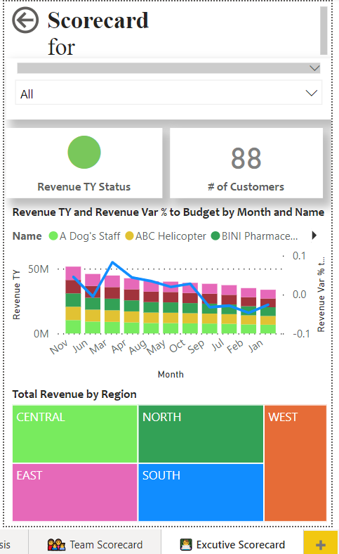
Customer Profitability Analysis
Executive Scorecard
Line and Clustered column chart is revel to Revenue TY and Revenue Var % to Budget by Month and Name. In November month revenue TY is raising high .this one maxim and here we can see in January month minim. Like march month Revenue Var % to Budget is maxim and minim in month of January.
Tree Map is showing Region wise Total Revenue.

Slide 8
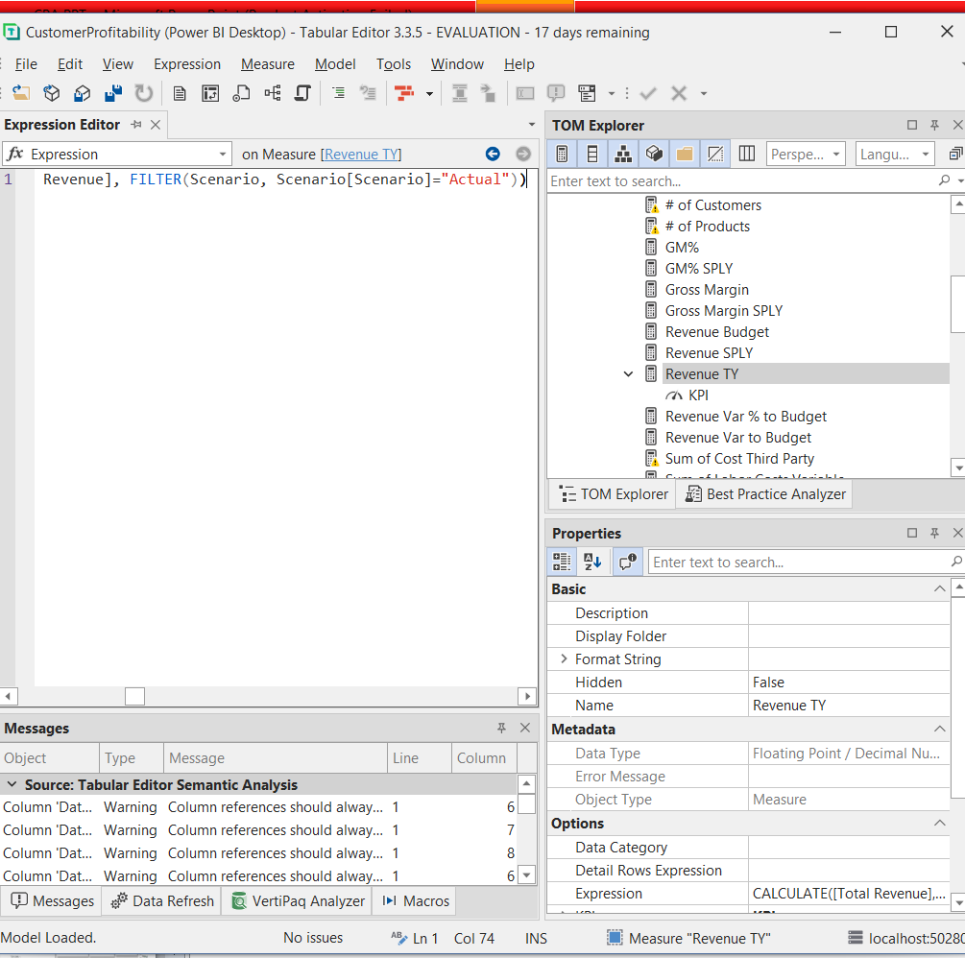

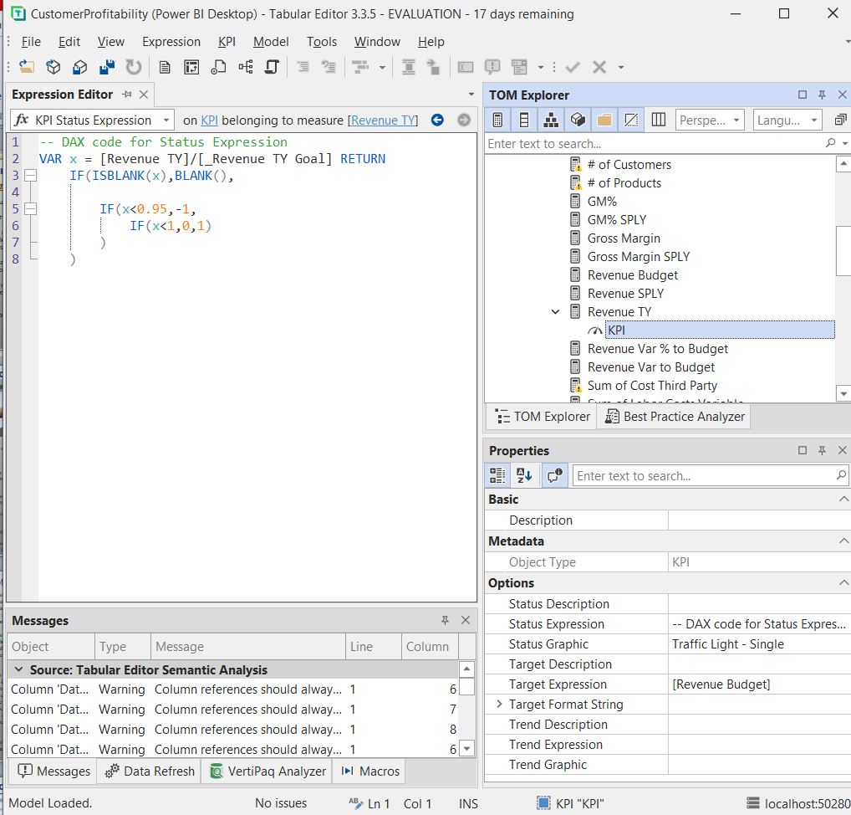
In Tabular editor we create one KPI to show measure column Revenue TY’s ‘Value’, ‘Goal’, and ’Status’ using simple “DAX code for Status Expression”.

Slide 9

Customer Profitability Analysis
Benefits of customer profitability analysis
Identify the most profitable customer
Develop marketing strategies
Strategies to discourage unprofitable customer
Level of service or onward charging to customer
Financial impact of changes to the customer mix
Cost of acquisition( total expense incurred by a business in acquiring a new client or purchasing an asset).
Product development for profitable customers

Slide 10

Customer Profitability Analysis

